Slide 1
WELCOME

Slide 2

CAP214: FUNDAMENTALS OF WEB PROGRAMMING
UNIT I: Web layout using HTML, Basics of HTML
UNIT II: Advanced concepts in HTML
UNIT III: CSS
UNIT IV: Javascript
UNIT V: Advanced concepts in Javascript
UNIT VI: Basics of Jquery, DOM using Javascript

Slide 3
Basics of HTML
Introduction
HTML is the standard markup language for web pages and web applications.
With HTML you can create your own Website.
HTML stands for HYPERTEXT MARKUP LANGUAGE.
This markup tells a web browser how to display the text, images and other form of multimedia on a webpage.
HTML elements are represented by tags
Container Tag/ Pair Tag: The first tag in a pair is the start tag, the second tag is the end tag. The end tag is written like the start tag, with a forward slash before the tag name.
Start and end tags are also called opening tags and closing tags. For ex <b> and </b>
Empty Tag: Only opening tag is used. For ex <br> or <hr>

Slide 4
What do I need to create HTML?
Computer
Text or HTML editor: For ex, HTML editors are Dreamweaver, SeaMonkey, Coffee Cup, TextPad etc.
The text editors are include Notepad(for windows), Pico(for Linux), or Simpletext/ text Edit/TexT.
Web Browser. For Ex Internet Explorer of Firefox
HTML VERSIONS
HTML 1991
HTML 2.0 1995
HTML 3.2 1997
HTML 4.01 1999
XHTML 2000
HTML 5 2014

Slide 5
World Wide Web
An information system on the internet which allows documents to be connected to other documents by hypertext links, enabling the user to search for information by moving from one document to another.
The World Wide Web—commonly referred to as WWW, W3, or the Web—is an interconnected system of public webpages accessible through the Internet.
The Web is not the same as the Internet: the Web is one of many applications built on top of the Internet. ... hypertext newsgroup, marking the moment the Web was first made public.
The Web is an information system where documents and other web resources are identified by Uniform Resource Locators (URLs, such as https://example.com/ ), which may be interlinked by hyperlinks, and are accessible over the Internet.

Slide 6
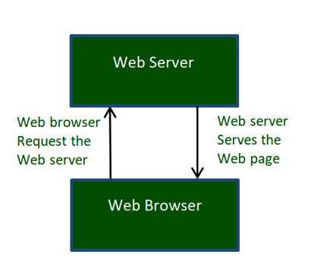
Cont.
Web, is a collection of websites or web pages stored in web servers and connected to local computers through the internet.
Users can access the content of these sites from any part of the world over the internet using their devices such as computers, laptops, cell phones, etc.

Slide 7
World Wide Web Consortium (W3C)
The World Wide Web Consortium (W3C) is committed to lead the Web to its full potential which includes promoting a high degree of usability for people with disabilities.
The Web Accessibility Initiative (WAI) develops its work through W3C’s consensus-based process, involving different stakeholders in Web accessibility.
These stakeholders include industry, disability organizations, government, accessibility research organizations, and more.
Five primary activities:
Ensuring that core technologies of the Web support accessibility.
Developing guidelines for Web content, user agents, and authoring tools.
Facilitating development of evaluation and repair tools for accessibility.
Conducting education and outreach.
Coordinating with research and development that can affect future accessibility of the Web

Slide 8
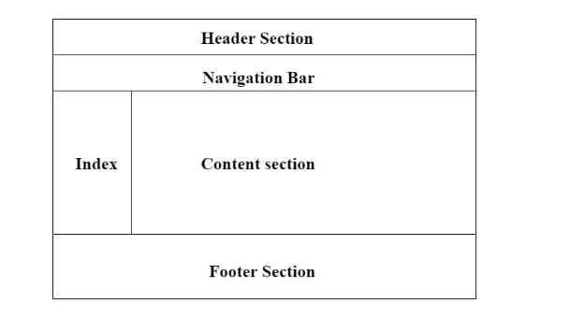
Web Page Layout Using HTML
Page layout is the part of graphic design that deals with the arrangement of visual elements on a page.
Page layout is used to make the web pages look better.
It establishes the overall appearance, relative importance, and relationships between the graphic elements to achieve a smooth flow of information and eye movement for maximum effectiveness or impact.

Slide 9
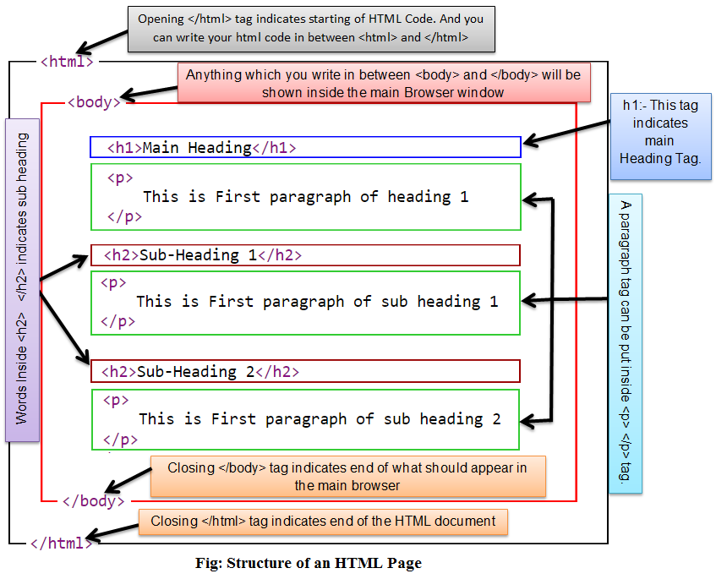
Structure of HTML page

Slide 10
Example Explained (Basic tags)
The <!DOCTYPE html> declaration defines that this document is an HTML5 document
The <html> element is the root element of an HTML page
The <head> element contains meta information about the HTML page
The <title> element specifies a title for the HTML page (which is shown in the browser's title bar or in the page's tab)
The <body> element defines the document's body, and is a container for all the, such as headings, paragraphs, images, hyperlinks, tables, lists, etc. visible contents
The <h1> element defines a large heading
The <p> element defines a paragraph

Slide 11
Formatting tags
<acronym> Not supported in HTML5. Use <abbr> instead. Defines an acronym
<abbr> Defines an abbreviation or an acronym
<address> Defines contact information for the author/owner of a document/article
<b> Defines bold text
<bdi> Isolates a part of text that might be formatted in a different direction from other text outside it
<bdo> Overrides the current text direction
<big> Not supported in HTML5. Use CSS instead. Defines big text
<blockquote> Defines a section that is quoted from another source
<cite> Defines the title of a work
<code> Defines a piece of computer code

Slide 12
Forms and Input tags
<form> Defines an HTML form for user input
<input> Defines an input control
<textarea> Defines a multiline input control (text area)
<button> Defines a clickable button
<select> Defines a drop-down list
<optgroup> Defines a group of related options in a drop-down list
<option> Defines an option in a drop-down list
<label> Defines a label for an <input> element
<fieldset> Groups related elements in a form
<output> Defines the result of a calculation

Slide 13
Image tags
<img> Defines an image
<map> Defines a client-side image map
<area> Defines an area inside an image map
<canvas> Used to draw graphics, on the fly, via scripting (usually JavaScript)
<figcaption> Defines a caption for a <figure> element
<figure> Specifies self-contained content
<picture> Defines a container for multiple image resources
<svg> Defines a container for SVG graphics

Slide 14
Question
Which of the following tag is used for inserting the largest heading in HTML?
<h3>
<h1>
<h5>
<h6>

Slide 15
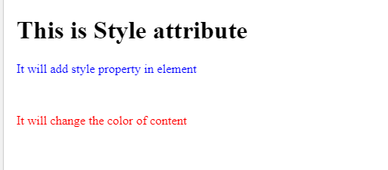
Example program & O/P
<!DOCTYPE html>
<html>
<head>
</head>
<body>
<h1> This is Style attribute</h1>
<p style="height: 50px; color: blue">It will add style property in element</p>
<p style="color: red">It will change the color of content</p>
</body>
</html>

Slide 16
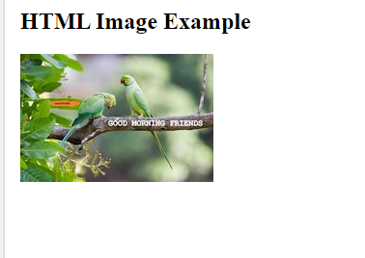
Web page Layout using HTML
Working with images in web pages (Background image, image map and image)
HTML img tag is used to display image on the web page. HTML img tag is an empty tag that contains attributes only, closing tags are not used in HTML image element.
<h2>HTML Image Example</h2>
<img src="good_morning.jpg" alt="Good Morning Friends"/>

Slide 17
Attributes of HTML img tag
The src and alt are important attributes of HTML img tag.
1) src
2) alt
3) width
4) height
Use of height and width attribute with img tag
<img src="animal.jpg" height="180" width="300" alt="animal image">

Slide 18
Common Image Formats
Abbreviation | File Format | File Extension
APNG | Animated Portable Network Graphics | .apng
GIF | Graphics Interchange Format | .gif
ICO | Microsoft Icon | .ico, .cur
JPEG | Joint Photographic Expert Group image | .jpg, .jpeg, .jfif, .pjpeg, .pjp
PNG | Portable Network Graphics | .png
SVG | Scalable Vector Graphics | .svg

Slide 19
Question
How to insert an image in HTML?
<img href = "jtp.png" />
<img url = "jtp.png" />
<img link = "jtp.png" />
<img src = "jtp.png" />

Slide 20
Question
Web browsers display images in the following format
XBM
JPEG
GIF
All of these

Slide 21
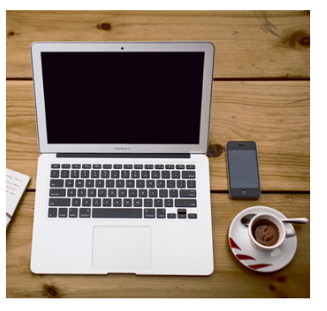
Image Map
The HTML <map> tag defines an image map. An image map is an image with clickable areas. The areas are defined with one or more <area> tags.

Slide 22
Question
The text specified in the alt attribute is displayed as tooltip in
Internet Explorer
Google Chrome
Both (a) and (b)
None of these

Slide 23
Question
The default alignment of images, that are inserted in Web page, is
left
right
inline with text
middle

Slide 24
Background Images
To add a background image on an HTML element, use the HTML style attribute and the CSS background-image property
Example : <div style="background-image: url('img_girl.jpg');">
Example : <style> div { background-image: url('img_girl.jpg'); } </style> -→ Specify the background image in the <style> element:

Slide 25
Background Repeat
If the background image is smaller than the element, the image will repeat itself, horizontally and vertically, until it reaches the end of the element:
Example <style> body { background-image: url('example_img_girl.jpg'); } </style>
To avoid the background image from repeating itself, set the background-repeat property to no-repeat. background-repeat: no-repeat;

Slide 26
Background Cover
If you want the background image to cover the entire element, you can set the background-size property to cover.
Also, to make sure the entire element is always covered, set the background-attachment property to fixed:
Example <style> body { background-image: url('img_girl.jpg'); background-repeat: no-repeat; background-attachment: fixed; background-size: cover; } </style>

Slide 27
Question
For specifying height and width of an image which attributes is used in image tag?
A) alt attribute
B) Height and width attribute
C) Style tag
D) Both A and C

Slide 28
Question
When should you use path along with file name of picture in IMG tag?
A) path is optional and not necessary
B) when the location of image file and html file are different
C) when image file and html file both are on same location
D) path is always necessary when inserting image

Slide 29
HTML Lists
HTML Lists are used to specify lists of information. All lists may contain one or more list elements. There are three different types of HTML lists:
Ordered List or Numbered List (ol)
Unordered List or Bulleted List (ul)
Description List or Definition List (dl)
**We can create a list inside another list, which will be termed as nested List.**

Slide 30
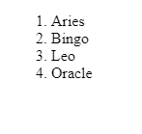
HTML Ordered List or Numbered List
In the ordered HTML lists, all the list items are marked with numbers by default. It is known as numbered list also. The ordered list starts with <ol> tag and the list items start with <li> tag.
Example Program: <html>
<body>
<ol>
<li>Aries</li>
<li>Bingo</li>
<li>Leo</li>
<li>Oracle</li>
</ol>
</body>
</html>

Slide 31
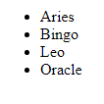
HTML Unordered List or Bulleted List
In HTML Unordered list, all the list items are marked with bullets. It is also known as bulleted list also. The Unordered list starts with <ul> tag and list items start with the <li> tag.
<ul>
<li>Aries</li>
<li>Bingo</li>
<li>Leo</li>
<li>Oracle</li>
</ul>

Slide 32
HTML Description List or Definition List
HTML Description list is also a list style which is supported by HTML and XHTML. It is also known as definition list where entries are listed like a dictionary or encyclopedia.
The definition list is very appropriate when you want to present glossary, list of terms or other name-value list.
The HTML definition list contains following three tags:
<dl> tag defines the start of the list.
<dt> tag defines a term.
<dd> tag defines the term definition (description).
</dl> − Defines the end of the list

Slide 33
Type attribute
we can use type attribute for <ol> tag to specify the type of numbering.
By default, it is a number
<ol type = "1"> - Default-Case Numerals.
<ol type = "I"> - Upper-Case Numerals.
<ol type = "i"> - Lower-Case Numerals.
<ol type = "A"> - Upper-Case Letters.
<ol type = "a"> - Lower-Case Letters.

Slide 34
Example program
<body>
<ol type = "1"> <ol type= "I" > , <ul type = "circle">, <ul type = "square">, <ul type = "disc">
<li>Beetroot</li>
<li>Ginger</li>
<li>Potato</li>
<li>Radish</li>
</ol>
</body>

Slide 35
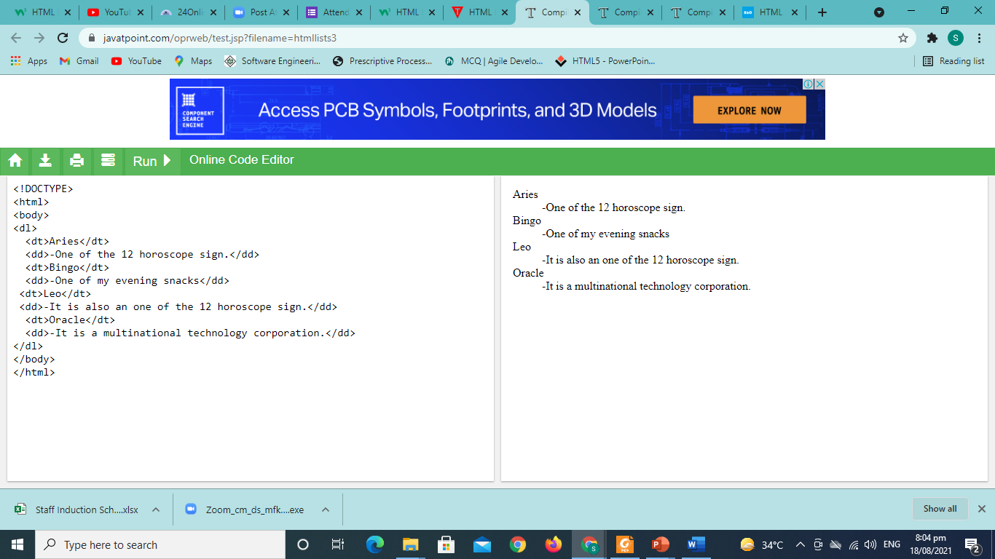
Example Program
<dl>
<dt>Aries</dt>
<dd>-One of the 12 horoscope sign.</dd>
<dt>Bingo</dt>
<dd>-One of my evening snacks</dd>
<dt>Leo</dt>
<dd>-It is also an one of the 12 horoscope sign.</dd>
<dt>Oracle</dt>
<dd>-It is a multinational technology corporation.</dd>
</dl>

Slide 36
Question
For arranging your list items in same way as they were arranged in dictionary which tag you will use?
A) <ul>
B) <ol>
C) <li>
D) <dl>

Slide 37
Question
An ordered list in HTML document starts with a
<ul > tag
<ol> tag
<li> tag
None of the above

Slide 38
HTML links- Hyperlinks
HTML links are hyperlinks.
You can click on a link and jump to another document.
When you move the mouse over a link, the mouse arrow will turn into a little hand.
** A link does not have to be text. A link can be an image or any other HTML element!**
Syntax: <a href="url">link text</a>
. The most important attribute of the <a> element is the href attribute, which indicates the link's destination.
The link text is the part that will be visible to the reader.
Clicking on the link text, will send the reader to the specified URL address

Slide 39
HTML Links - The target Attribute
The target attribute specifies where to open the linked document.
The target attribute can have one of the following values:
_self - Default. Opens the document in the same window/tab as it was clicked
_blank - Opens the document in a new window or tab
_parent - Opens the document in the parent frame
_top - Opens the document in the full body of the window
Link to an Email Address : Use mailto: inside the href attribute to create a link that opens the user's email program (to let them send a new email):
Example: <a href="mailto:someone@example.com">Send email</a>
Button as a Link :JavaScript allows you to specify what happens at certain events, such as a click of a button
Example <button onclick="document.location='default.asp'">HTML Tutorial</button>
Try it Yourself »

Slide 40
HTML image links
It's simple to use an image as hyperlink.
We just need to use an image inside hyperlink at the place of text as shown below −
Example : <body>
<p>Click following link</p>
<a href = "https://www.spoint.com" target = "_self">
<img src = "/images/logo.png" alt = “SPoint" border = "0"/>
</a>
</body>

Slide 41
Mouse-Sensitive Images
There are two ways to create image maps −
Server-side image maps − This is enabled by the ismap attribute of the <img> tag and requires access to a server and related image-map processing applications.
Client-side image maps − This is created with the usemap attribute of the <img> tag, along with corresponding <map> and <area> tags.

Slide 42
Coordinate System
The actual value of coords is totally dependent on the shape in question. Here is a summary, to be followed by detailed examples −
rect = x1 , y1 , x2 , y2
circle = xc , yc , radius
poly = x1 , y1 , x2 , y2 , x3 , y3 , ... xn , yn
** All coordinates are relative to the upper-left corner of the image (0,0). Each shape has a related URL. You can use any image software to know the coordinates of different positions.**

Slide 43
Question
Ismap attribute makes a special image when user click somewhere on image
A) It blinks
B) It hides
C) It opens a hyper link
D) All of above

Slide 44
Question
A webpage displays a picture, what tag was used to display that picture?
A) picture
B) image
C) img
D) src

Slide 45
Fonts in web pages
In particular, there are 10 web fonts that we use quite frequently in our web projects.
Each font family has its own character, look, feel and different variations.
With a rich selection of styles for each of these fonts, there are many ways to incorporate them into our web designs.
ARVO
PLAYFAIR DISPLAY
YELLOWTAIL
MERRIWEATHER
TITILLIUM SANS AND DOSIS
ALEGREYA
OPEN SANS

